Slide 1


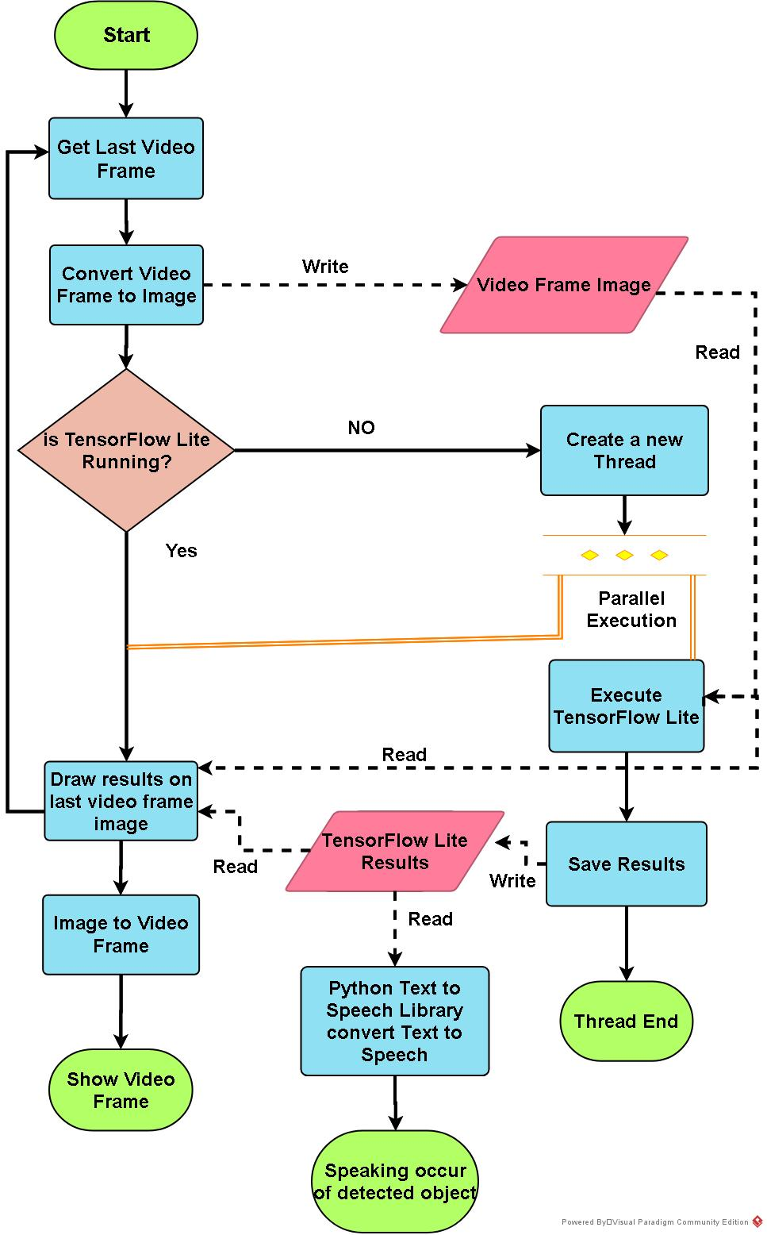
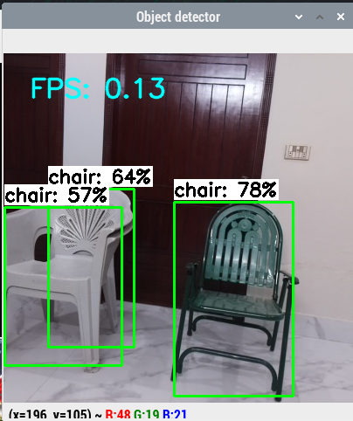
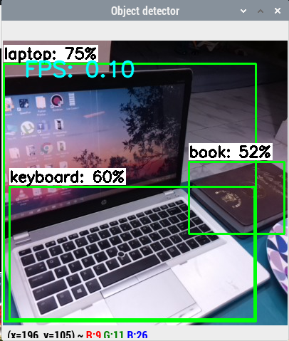
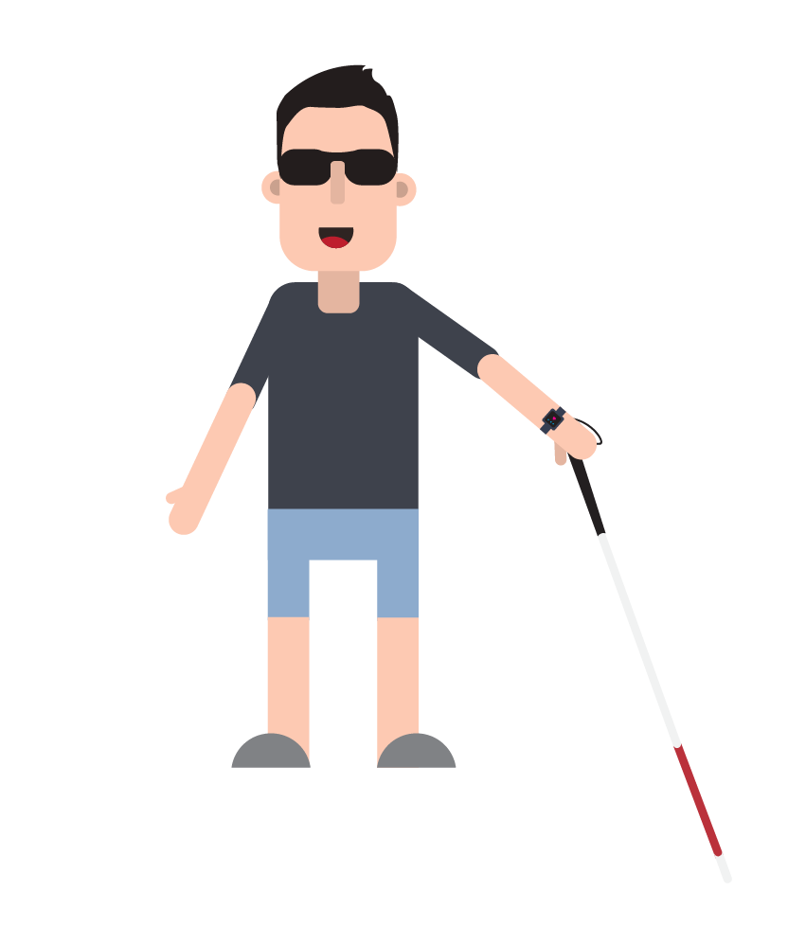
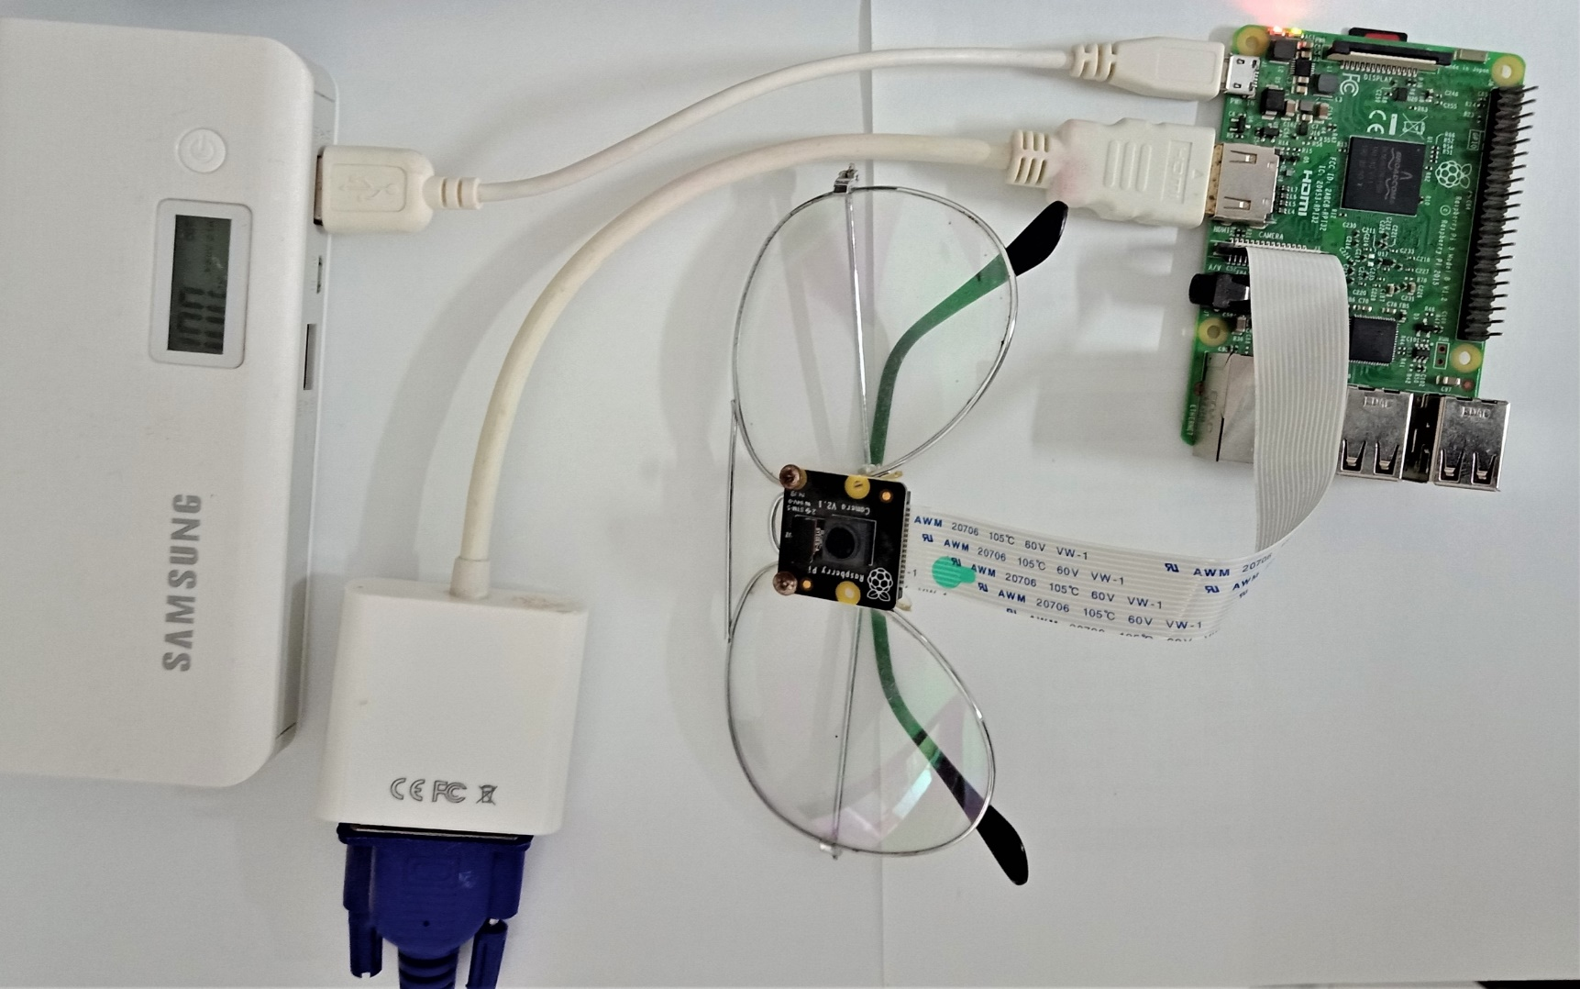
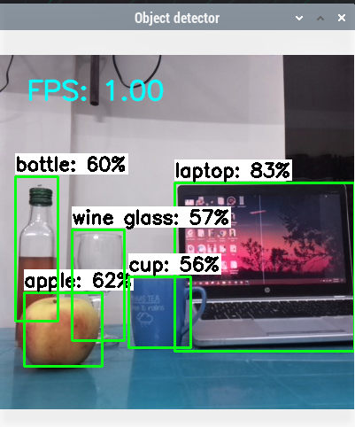
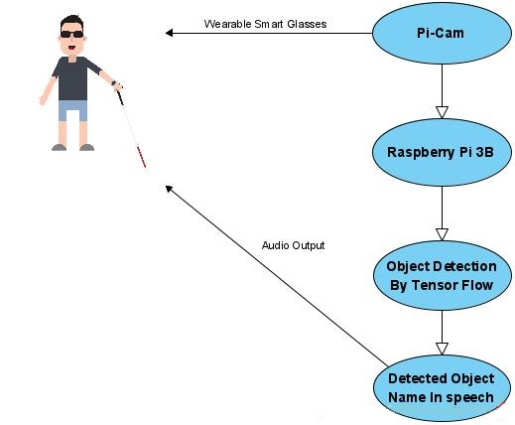
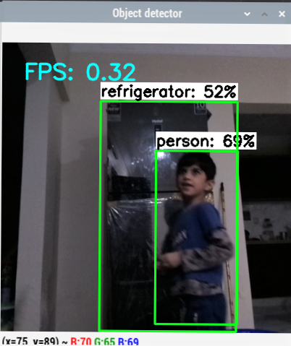
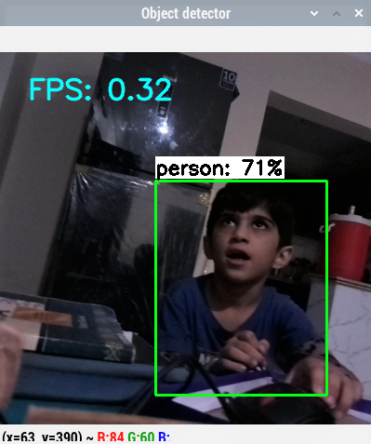
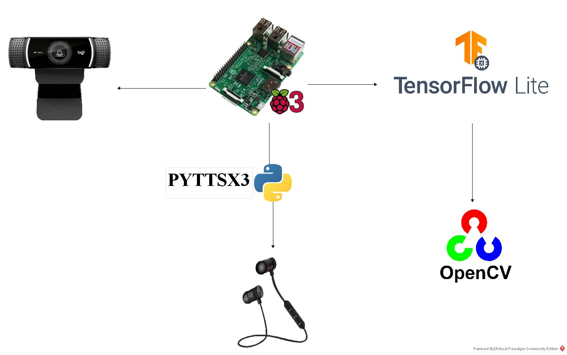
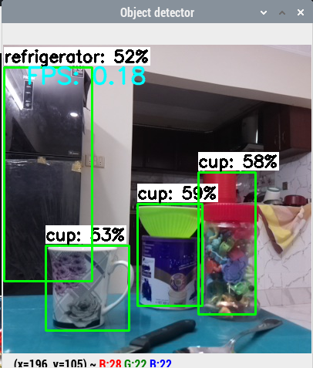
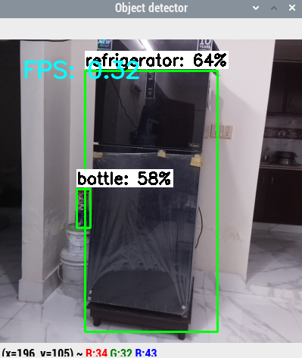
Smart Glasses For Visually Impaired People
Uzaif Talpur (F16CS49), Iqra Asghar Ansari (F16CS15) and Syeda Hamna Kazmi (F16CS169)
Supervised by: Dr. Muhammad Ahsan Ansari
Introduction
This project Smart Glasses for Visually Impaired People is specifically dedicated to blind people, as this can help them, be independent in life.
According to a study by “WHO” there are about 285 million people in the world who are subjected to visual impairments.
246 million people are having decreased vision perception and 39 million are blind.
The majority of people with poor vision are mostly people over the age of 50.
With the growing population and the number of visually impaired people a prominent solution was required.
Every day these visually impaired people face various problems and difficulties in understanding and interacting with their surroundings.
The targeted vision category is medium distance vision as in daily life activities to perceive environment objects
It detects objects from the environment and acknowledges the blind person through an audio guide message via earphone
This proposed prototype is based on Raspberry Pi, Pi camera, earphones, OpenCV, and Tensor flow Lite framework.
This device will help visually impaired people to gain increased independence and freedom
So that in daily life can they easily interact with the indoor and outdoor environments.
Figure.9.Detection of Multiple Chairs
Figure.3.Implemented Methodology Working Diagram
Figure.10.Detection of Laptop, Keyboard and a Book
Objectives
The goal is to create a real-time low-cost, effective, AI-powered mobile guide for blind/visually impaired people
By using image processing techniques with the audio description as a gadget for visually impaired people so that they can easily interact with the environment.
The main aim of this project is to design and implement a type of smart glasses,
This assists to detect the surrounding objects and acknowledges the blind person can easily make decisions independently
Figure.4.Complete connected interfaces in Raspberry Pi 3B
Results
Experimental design
The results achieved in different environmental conditions are given below, here object detection occurred in different variants of light condition, which also affects the inference percentage.
23.55
31.66
Figure.11.Detection of Laptop, apple, bottle, wine glass and a cup
There were a total of 15 different and multiple objects detected.
In this project a maximum 83% accuracy is achieved.
Every detected object label will be converted to speech in a loop
Conclusions
Figure.1.Usecase Diagram of Smart Glasses for Visually Impaired People
This project intends to help visually impaired people by detecting objects in their surroundings and giving them a description of those objects.
The description of objects is delivered in an audio format using an earphone.
TensorFlow Lite Object Detection Model is used which is dedicated to embedded and mobile devices.
The TensorFlow Lite Model which is used in this project is coco_ssd_mobilenet_v1_1.0_quant_2018_06_29 model.
The accuracy levels are quite satisfactory to reach 83% overall in mobile devices.
In the future, different object detection models can be used, and more features should be added.
The improvements in the quality of hardware should be made. A Coral USB Accelerator can be used to accelerate the inferencing of the model.
The implemented design is based on two sections Hardware and Software.
The hardware section includes the Raspberry Pi 3 Model B, Raspberry Pi-Camera and earphones.
The software section is based on Tensor Flow Lite and OpenCV framework implemented through Python Language
Figure.5.Detection of person and refrigerator
Figure.6.Detection of a person
References
Figure.2.Block Diagram of Smart Glasses System
G. Chandan, A. Jain, H. Jain and Mohana, "Real Time Object Detection and Tracking Using Deep Learning and OpenCV," 2018 International Conference on Inventive Research in Computing Applications (ICIRCA), Coimbatore, 2018, pp. 1305-1308, doi: 10.1109/ICIRCA.2018.8597266.
S. Pehlivan, M. Unay and A. Akan, "Designing an Obstacle Detection and Alerting System for Visually Impaired People on Sidewalks," 2019 Medical TechnologiesCongress (TIPTEKNO), Izmir, Turkey, 2019, pp. 1-4, doi: 10.1109/TIPTEKNO.2019.8895181
W. Chang, L. Chen, C. Hsu, J. Chen, T. Yang, and C. Lin, "MedGlasses: A Wearable Smart-Glasses-Based Drug Pill Recognition System Using Deep Learning for Visually Impaired Chronic Patients," in IEEE Access, vol. 8, pp. 17013-17024, 2020, doi: 10.1109/ACCESS.2020.2967400.
Andrew G. Howard, and Hartwig Adam, “MobileNets: Efficient Convolutional Neural Networks for Mobile Vision Applications”, Google Inc., 17 Apr 2017INcarXiv: 1704.04861v1
This project starts from the configuration of Raspberry Pi 3 B and Pi-Camera (rev 2.0).
Then run the TFLite_detection_webcam.py in the Linux LX-Terminal under Pi OS.
The above Python script file will start the object detection model by fetching frames from Raspberry Pi-Camera in real-time live streaming.
OpenCV is responsible for the Pre-processing of frames.
Inference process happens in the Tflite file this includes a detection graph and labelmap for labels.
Google quantized sample model for object detection “coco-ssd-mobilenet-v1-1.0-quant-2018-06-29” is used here
Figure.7.Detection of refrigerator and 3 Cups
Figure.8.Detection of refrigerator & bottle
Mehran University of Engineering and Technology, Jamshoro
Department of Computer Systems Engineering

